Slide 1
Tuesday, September 8, 2020
Objective: SWBAT- identify the class/Teams guidelines and expectations for the 2020-2021 school year
Do Now: In the chat, please type in something about yourself, something you are looking forward to this school year and something you may be concerned about. (4 minutes)

Slide 2
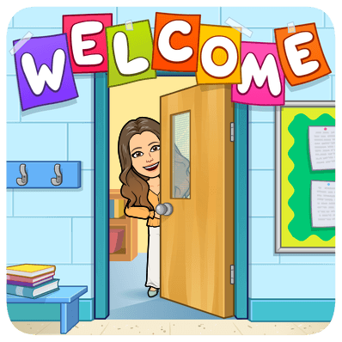
Mrs. Potter English 9 2020-2021

Slide 3
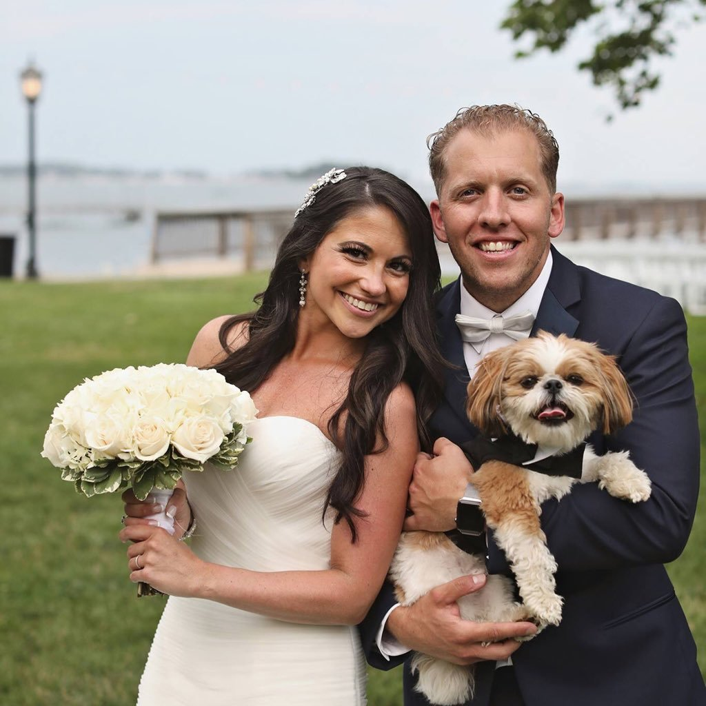
About Me
Proud puppy mama to Louie and wife to Spencer
Teaching for 15 years; this is my 6th year @GHS
Love: anything that requires being outside, traveling, cooking, reading, coffee, quality time with family & friends and laughing!
Extremely passionate about my profession and, at times, can be super cheesy.

Slide 4
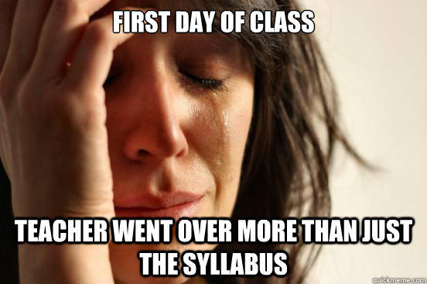

Slide 5
Course Objectives
Improve word recognition, fluency, and vocabulary development
Increase reading comprehension and develop good reading habits in and out of the classroom, while providing frequent opportunities for students to respond critically, reflectively, and imaginatively to a range of reading materials.
Introduce various genres of literature.
Provide an in-depth introduction to close-reading, annotating, and analyzing fiction and non-fiction.
Provide instruction in all phases of the writing process.
Provide numerous practices for evidence-based writing.
Provide opportunities to develop and use effective listening and speaking techniques and strategies in both formal and informal situations.
Provide opportunities to use accountable talk during whole class and group discussions.

Slide 6
Class Expectations
Please sign in on time! (Refer to bell schedule for period times)
Please be appropriately dressed and in an area where you are free of distractions
ALWAYS use appropriate language and have manners
Be considerate of others

Slide 7
Just C-A-R-E
C- Considerate
A- Appropriate
R- Respectful and Responsible
E- Etiquette

Slide 8
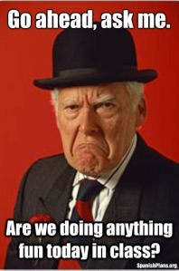
Routines & Tasks
Before you sign in to class, please be sure you are free of any distractions (phones/TV, video games, etc.).
Do Now’s will start every class period. The expectation is that upon entering class, you immediately begin working on the Do Now.
Class time will be a combination of direct instruction, independent practice, class discussion, and group activities.

Slide 9
Class Policy:
R-E-S-P-E-C-T

Slide 10
Class Policy:
2. Responsibility

Slide 11
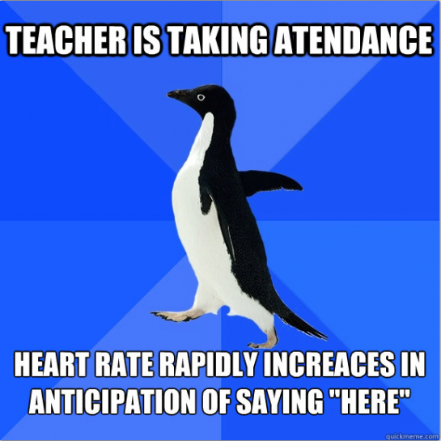
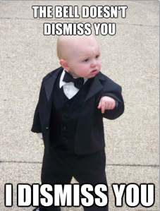
Class Policy:
3. Attendance

Slide 12
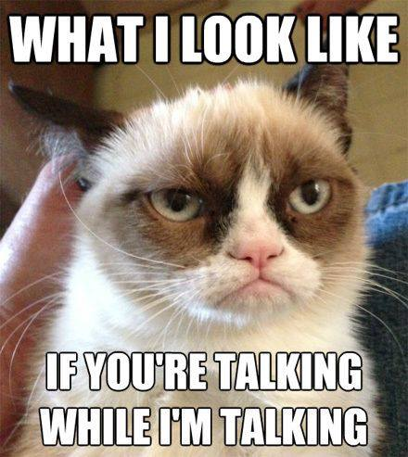
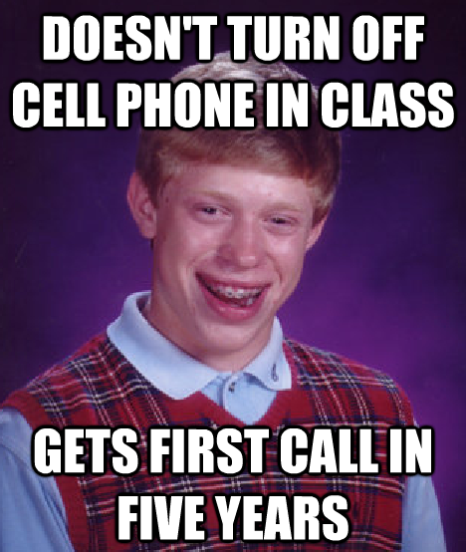
Class Policy:
4. Focus & Preparedness

Slide 13
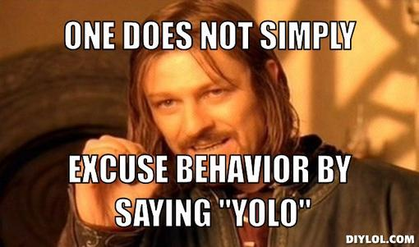
Class Policy:
5. Behavior & Attitude

Slide 14
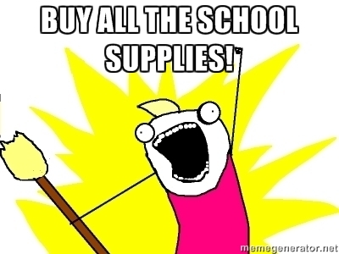
Class Materials:
Due to the fact that we will begin instruction remotely, you will only need some form of technology to access our Teams page/class periods. If you plan to print reading materials, a highlighter would be beneficial when/for annotating.

Slide 15
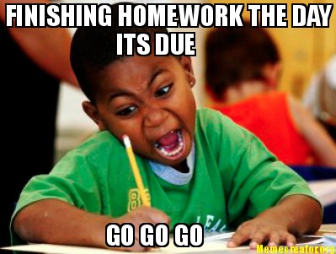
Homework
Homework may include an extension of in-class assignments, projects, essays or discussion board posts. All homework/work is due on the date given; NO EXCEPTIONS!
All work will be graded!

Slide 16
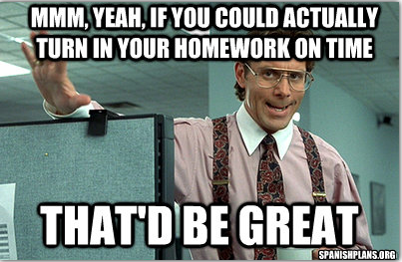
Late Work
Students are expected to submit homework and all assignments on the due date given.
Parents contacted on major assignments OR when missing work exceeds three assignments.

Slide 17
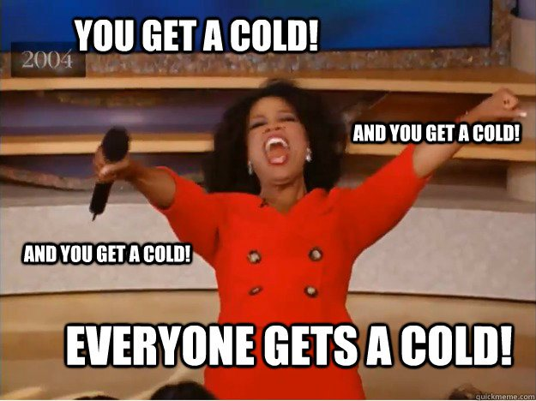
Make-up Work
Responsibility of the student to get the missed information/assignment!
Work should be made up within one day for each class day missed.

Slide 18
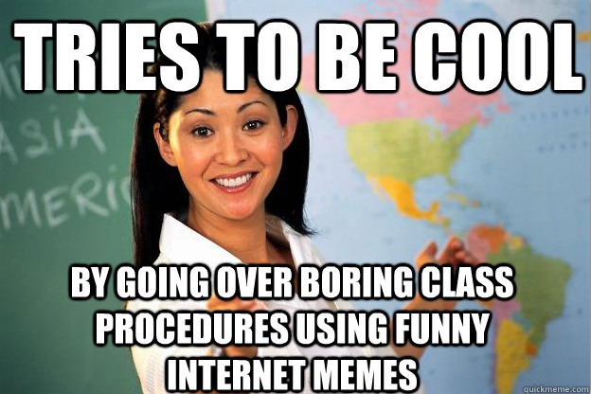

Slide 19
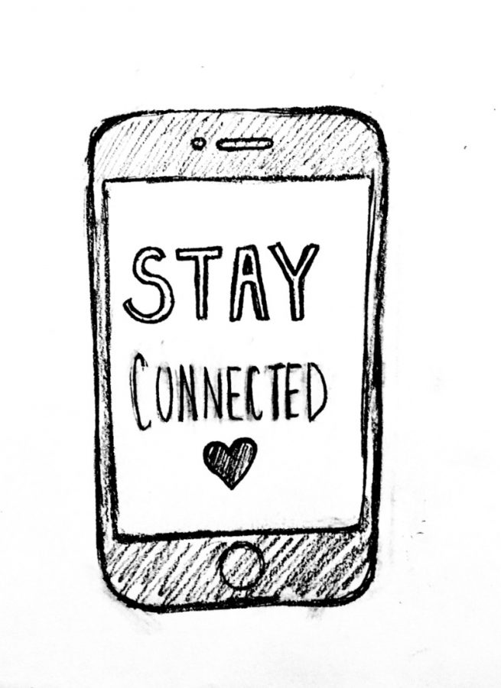
Stay Connected!
Communication is so important, especially now! Please do not hesitate to contact me with any questions, concerns or issues you may have!
npotter@yonkerspublicschools.org
Message me on Microsoft Teams
Call me at the school: GHS 914-376-8350

Slide 20
FOLLOW OUR INSTAGRAM PAGE!
Gorton_Class_of_2024

